Slide 1

Temperature Based Fan Control and Monitor System
Presented by
Anant Krishna (1NH17EE003)
Jaydeep Maity (1NH17EE022)
Sangam Jain (1NH17EE050)
Guide
Mr. Vinod Kumar S
Senior Assistant Professor
EEE Dept, NHCE

Slide 2
Introduction
In present scenario, availability of electricity is found to reach crucial stage. To protect and safeguard one's future we need to save the energy. As a slogan suggest "One unit saved is one unit generated".
The project is a standalone automatic fan speed controller that controls the speed of an electric fan according to our requirement. Arduino microcontroller allows dynamic and faster control. The sensed temperature and fan speed level values are simultaneously displayed on the LCD panel.
The applications areas of this project are air-conditioners, water-heaters, snow melter, ovens, heat-exchangers, mixers, furnaces, incubators, thermal baths and veterinary operating tables.

Slide 3
Literature survey
Applied Research of the Intelligent Temperature-Controlled Speed Adjustable Motor in Radiator Fan
Year: 2012, Volume: 1, Pages: 779-782DOI Bookmark:10.1109/ISdea.2012.744
Authors Shengwei Dai Yanlin Li
Considering the characteristics of the temperature monitoring under complex working condition, this paper suggests a kind of practical, simple and low-cost control method for the intelligence motor. This method uses AT89S52 and a few periphery components as a control system, and has two control modes. In one mode, the control system takes a real-time monitoring on ambient temperature, and correspondingly changes the revolving speed of motor, providing efficient heat dissipation. And the other Mode 2 provides a way of using remote infrared control to manually achieve the same goal. Through the practical operation, this control system shows its effectiveness and stability. And because of its low cost, it can be used widely in radiator fans.

Slide 4
Literature survey
Data Driven Electricity Management for Residential Air Conditioning Systems: An Experimental Approach
July-Sept. 2019, pp. 380-391, vol. 7DOI Bookmark: 10.1109/TETC.2017.2655362
Authors Wen-Tai Li Sai Ram Gubba
Effective control of air conditioning systems (ACs) has the potential of significant electricity savings and demand response management for an entire power system. In this context, this paper demonstrates some key experimental results on controlling the electricity consumption of ACs. In particular, the degree to which energy can be throttled for energy management purposes without affecting the end user's comfort level is described. The testbed was set up in a residential building, in which the set point temperature of ACs installed within each apartment unit is controllable from a remote server. The main objectives were to reduce the consumption of electricity by the compressors, and to investigate the feasibility of having residential ACs as interruptible loads to participate in the electricity market. The algorithm used for controlling is explained in detail, and the users' experiences during the experiments are briefly discussed.

Slide 5
Proposed Methodology
In this based project, we are going to control DC fan speed according to the room temperature and show these parameter changes on a 16x2 LCD display. It is accomplished by the data communications between Arduino, LCD, LM35 sensor Module and DC fan that is controlled by using PWM. PWM is a technique by using which we can control voltage. This project consists of three sections. One senses the temperature by using humidity and temperature sensor namely LM35. Second section reads the LM35 sensor module’s output and extracts temperature value into a suitable number in Celsius scale and control the fan speed by using PWM. And last part of system shows humidity and temperature on LCD and Fan driver.

Slide 6
Block Diagram
Temperature Sensor
Arduino UNO
Fan
LCD Display
Power Supply
9V DC supply

Slide 7
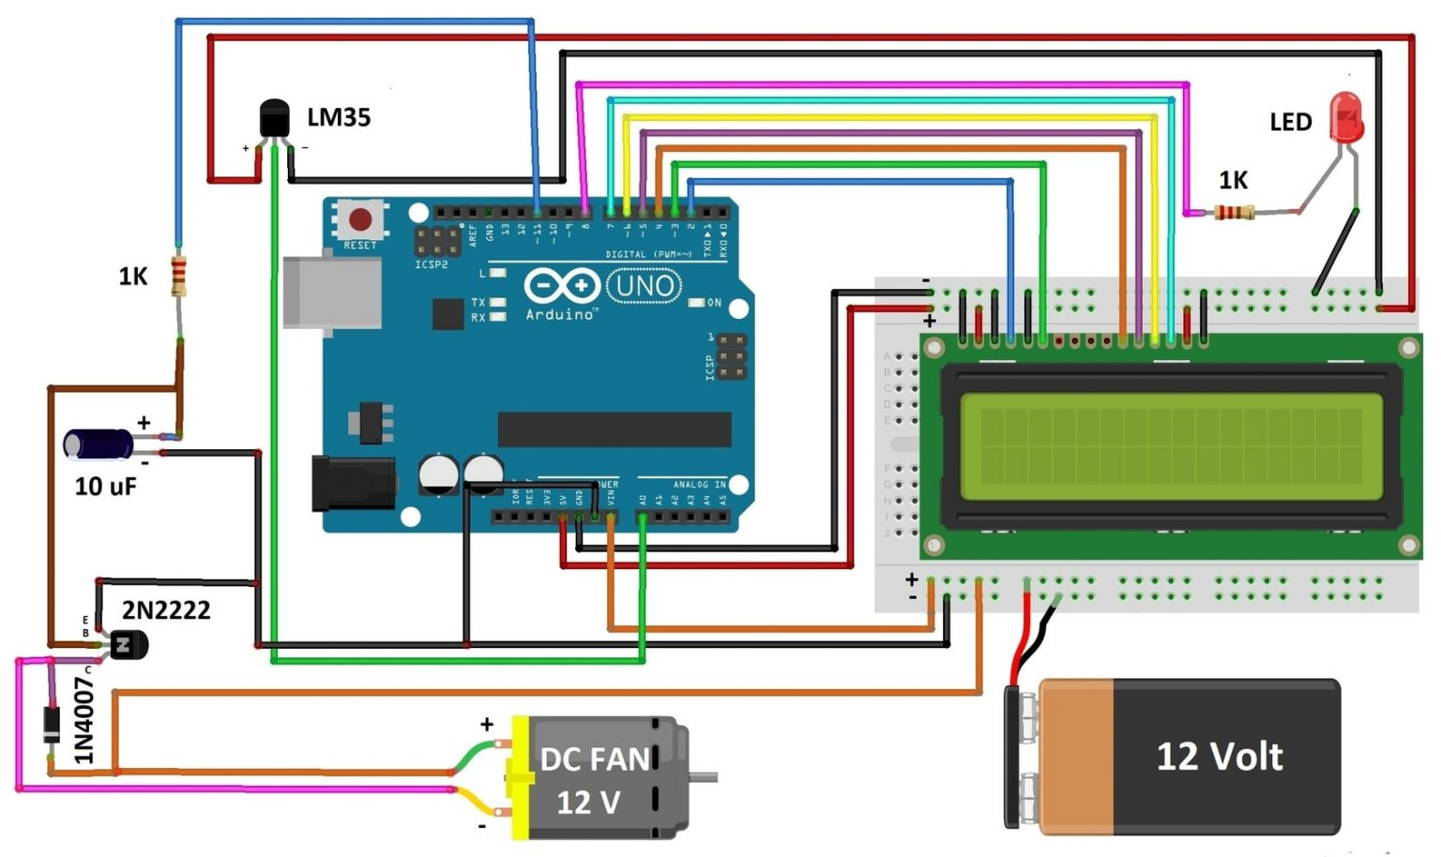
Circuit Diagram

Slide 8
Expected output / results
Speed of the fan is either increased or decreased automatically according to the temperature of the room.
Operating speed of the fan and temperature of the surrounding is displayed in the LCD

Slide 9
Conclusion
According to the above mentioned methodology and circuit diagram, we hope to get the required output.
THANK YOU

